Slide 1
Data Visualization of Bird Strikes between 2000 – 2011

Slide 2
Objective:
Analysis of the damage occurred due to Bird strikes on Airlines

Slide 3
Structure of DataSet
Sample file name (Bird Strikes Final)
Number of rows - 26
Number of Columns - 25559

Slide 4
Architecture
Collect data
Data Validation
Data Transformation
Result
Export data to Tableau

Slide 5
Introduction
Bird migration throughout the months of March through April and August through November causes an increase in the danger of bird strikes. Each year, bird and other wildlife strikes on aeroplanes cost the U.S. military and civil aviation approximately 600 million dollars in damage, endangering the lives of both crew members and passengers. Worldwide, wildlife strikes have resulted in the deaths of more than 195 people since 1988.

Slide 6
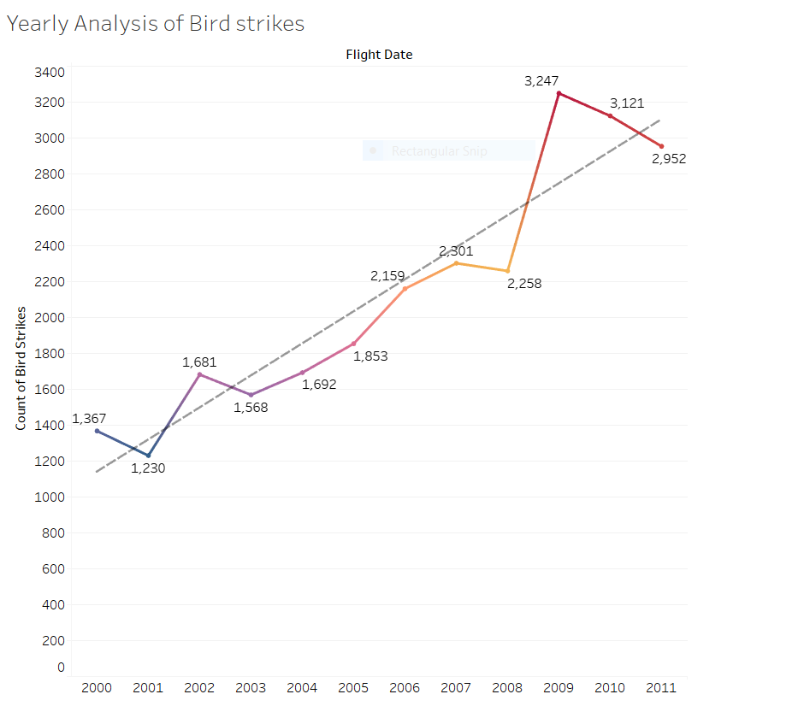
Yearly Analysis Of bird strikes

Slide 7
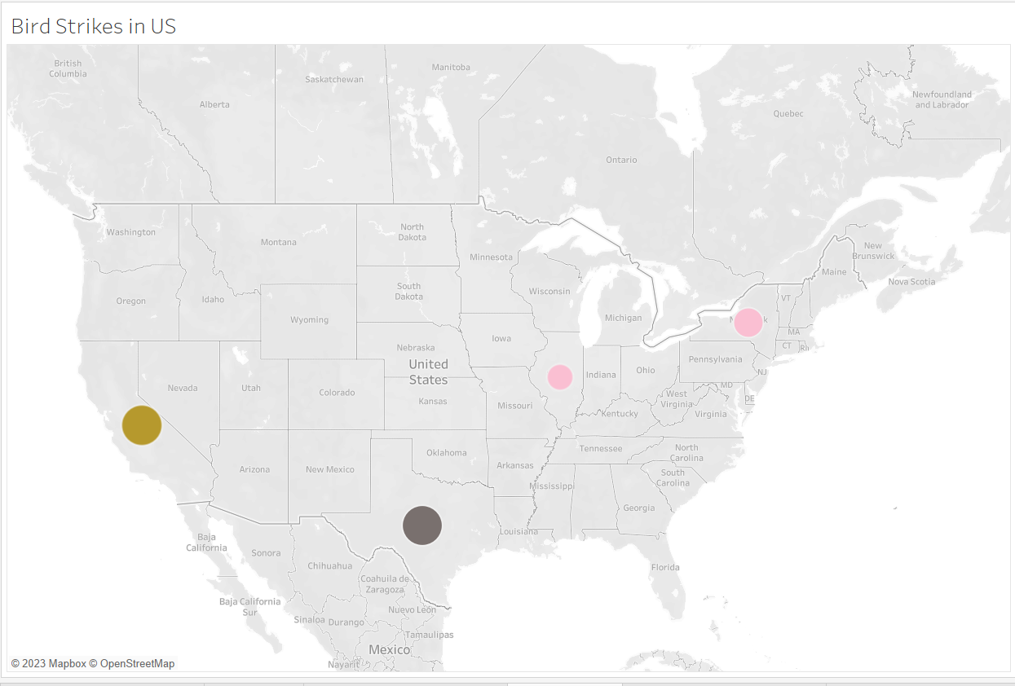
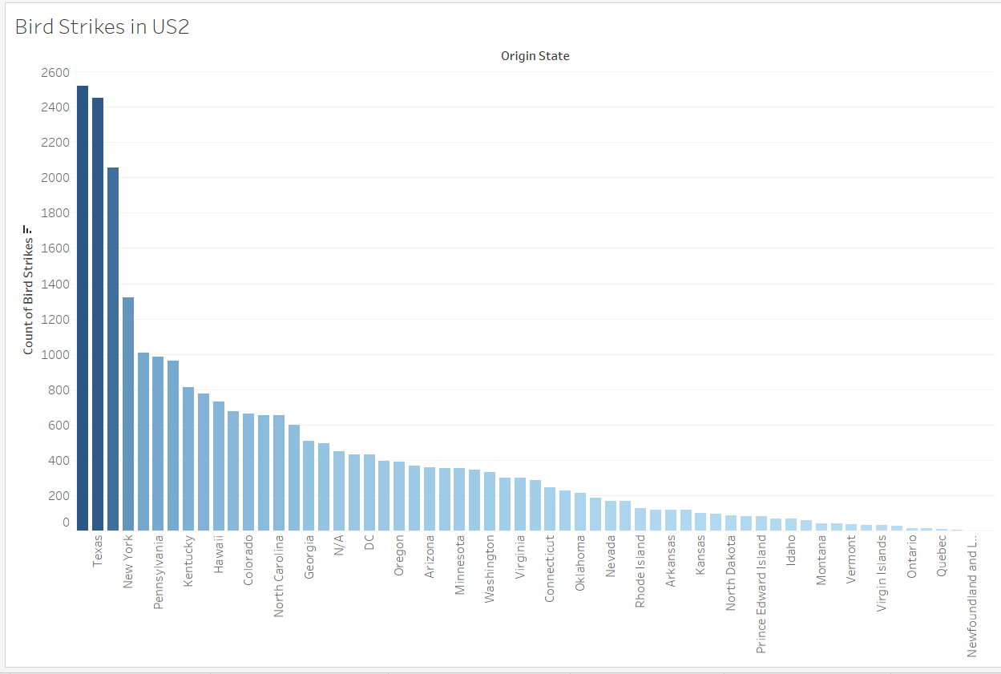
Bird Strikes in US(TOP Effected)

Slide 8
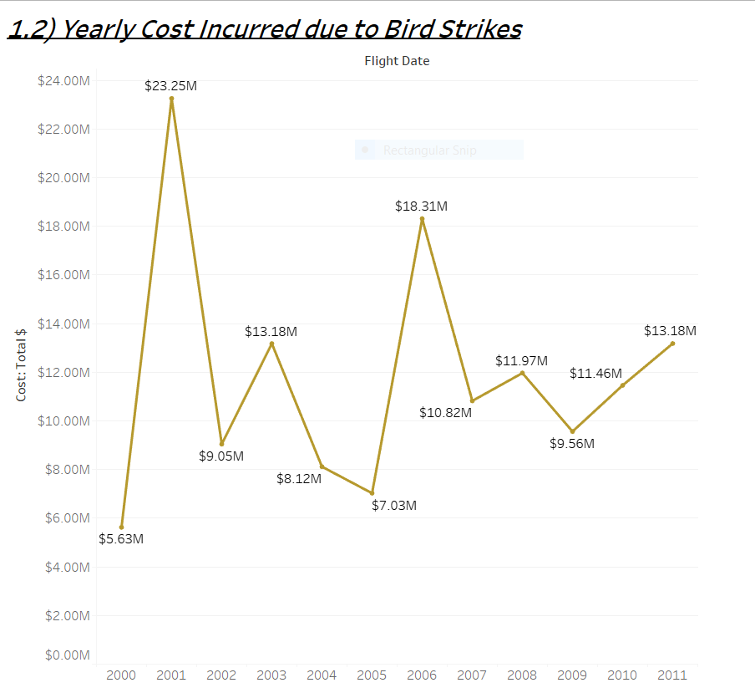
Yearly Cost Incurred due to Bird Strikes

Slide 9
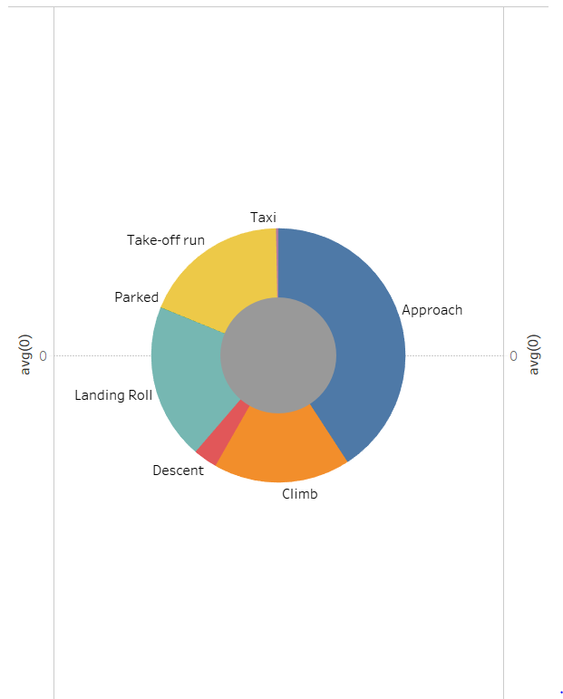
Phase of flight at the time of strike

Slide 10
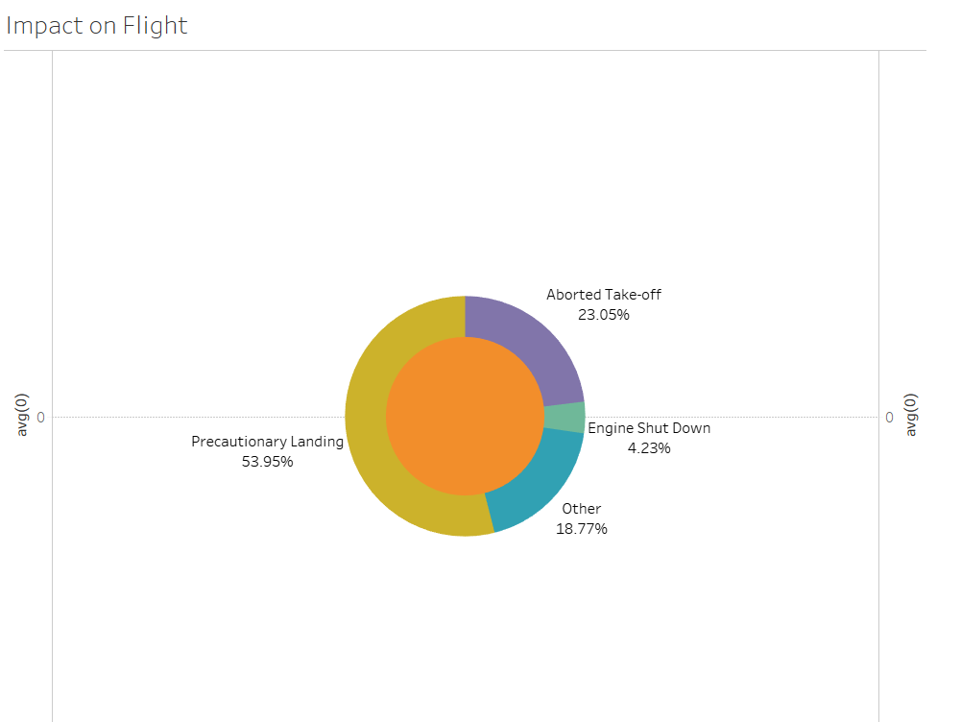
Impact on Flight

Slide 11
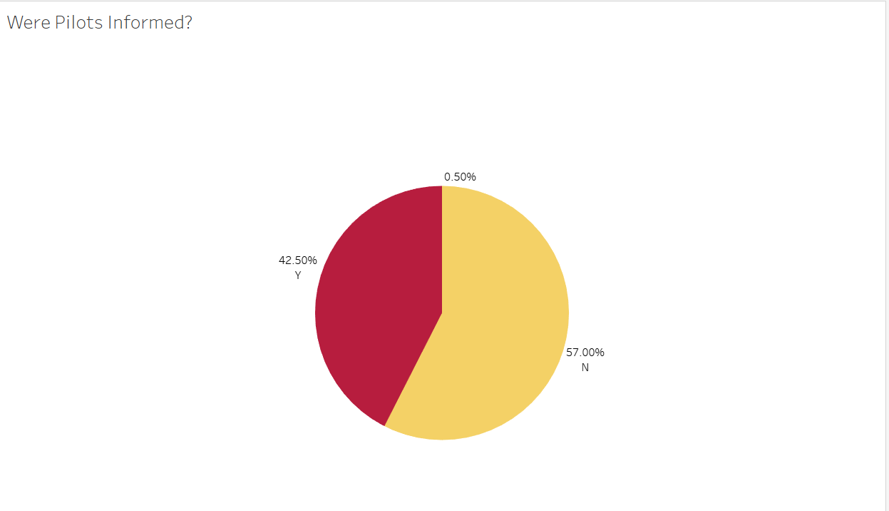
Pilots Informed About The STrike

Slide 12
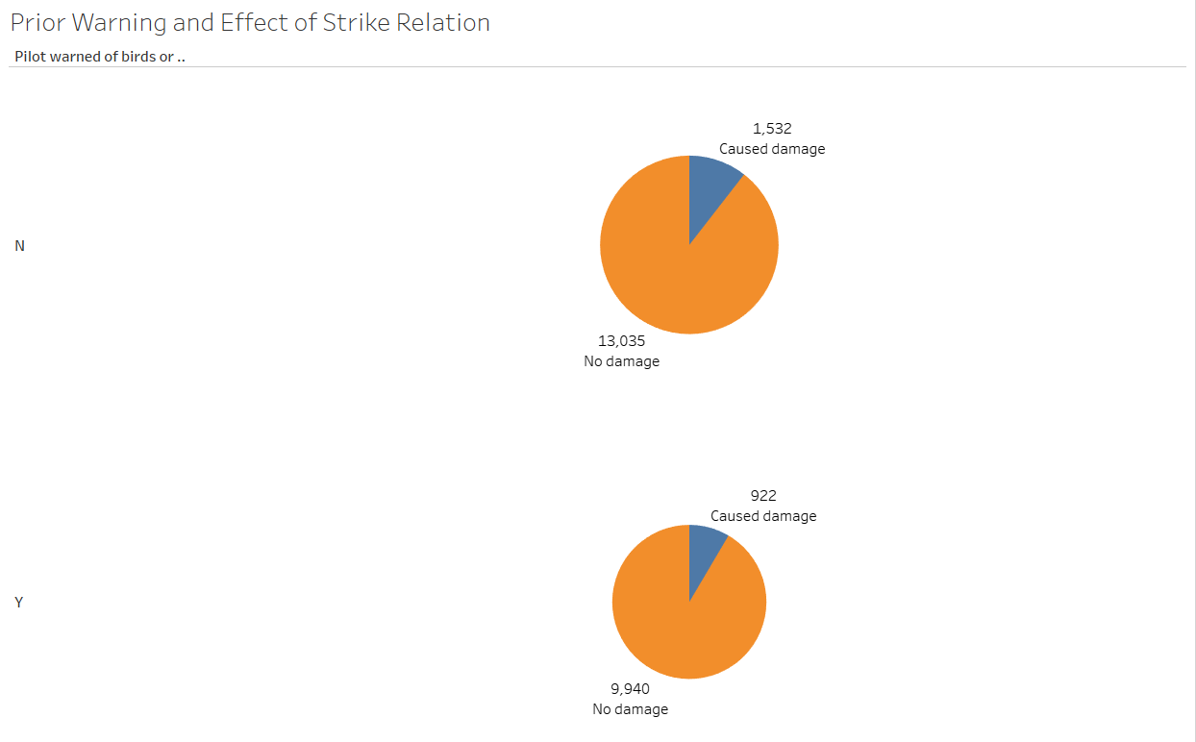
Prior Warning and Effect of Strike Relation

Slide 13
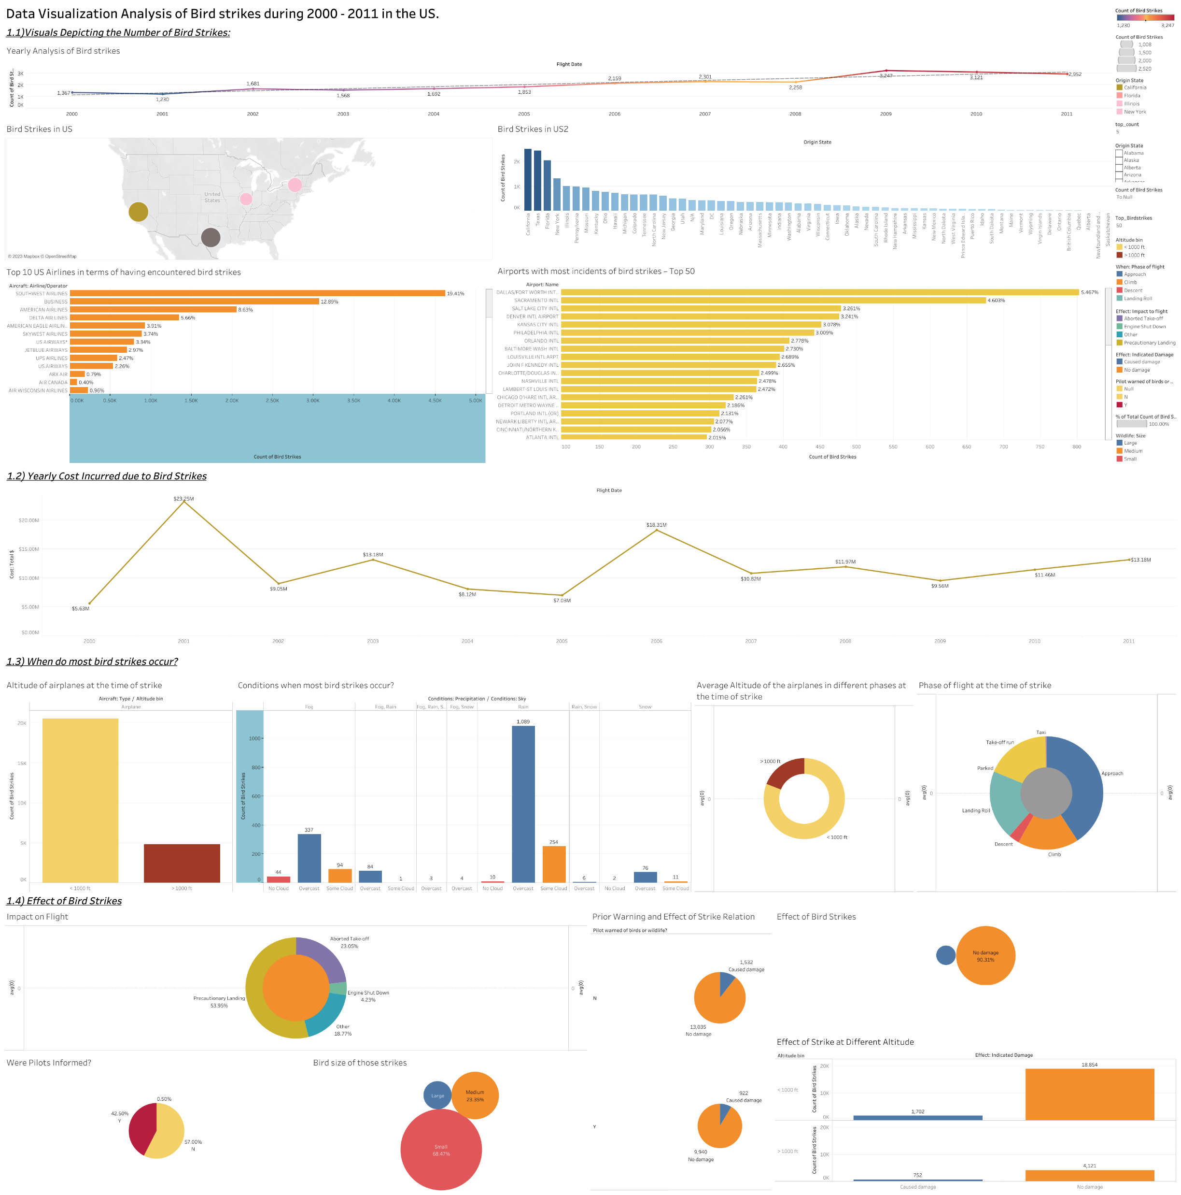
Analysis of Bird strikes Dashboard

